Slide 1
Black Jack
Project Week 1 – Games - Vicky Zauner
♠️♥️♣️♦️

Slide 2
Goal : Program Blackjack
Researching Rules:
Player vs. Dealer
Each get 2 Cards
Player only knows one of the Dealer’s cards
Deck
A can be either 1 or 11
Goal is to reach a Sum closer to 21
21 is Blackjack
Player loses if his sum is more than 21
Or if his sum is further from 21 than the dealer’s cards sum

Slide 3
Step 1
Wrote a list of things I had to define in Jupyter Notebook
# Summing up the steps and giving me structure of what I had to code here
Left out everything difficult
Programmed a simple game of Blackjack
Took notes

Slide 4
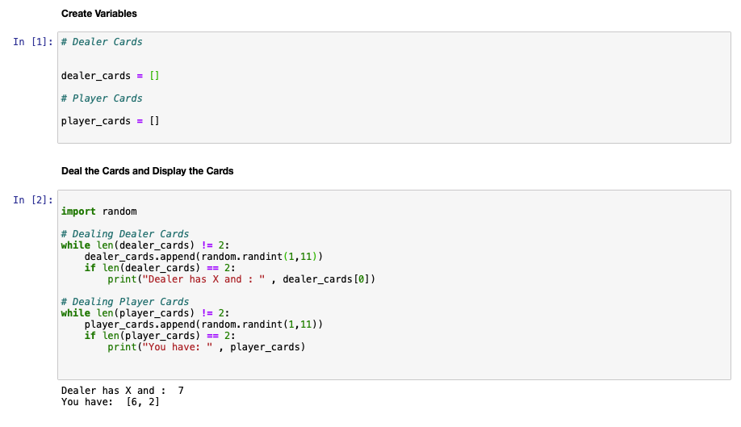
Screenshots Version 1

Slide 5
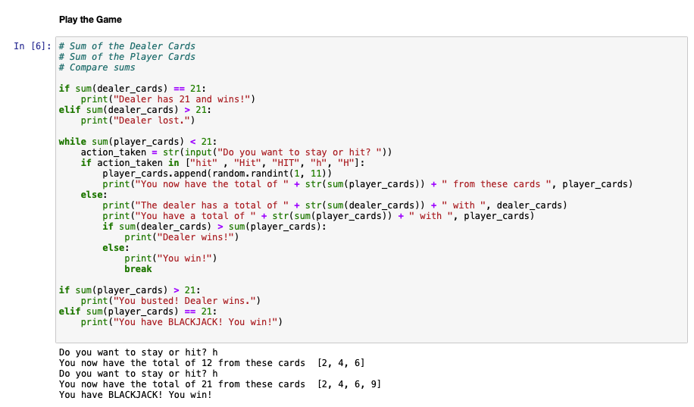
Screenshots Version 1 👩🏼‍💻
🏆

Slide 6
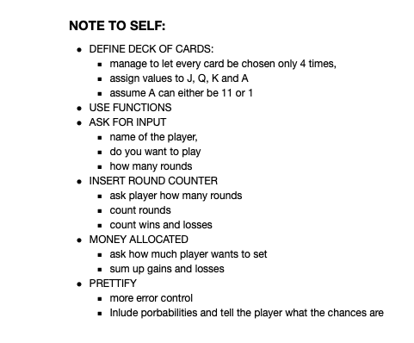
After Version 1

Slide 7
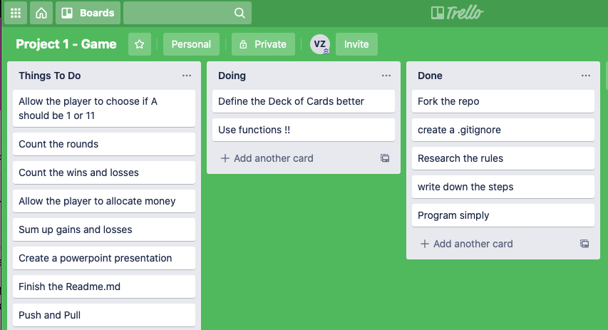
Trello Board

Slide 8
Step 2
Define the deck of cards
Use a function
Dealer does not hit above 17

Slide 9
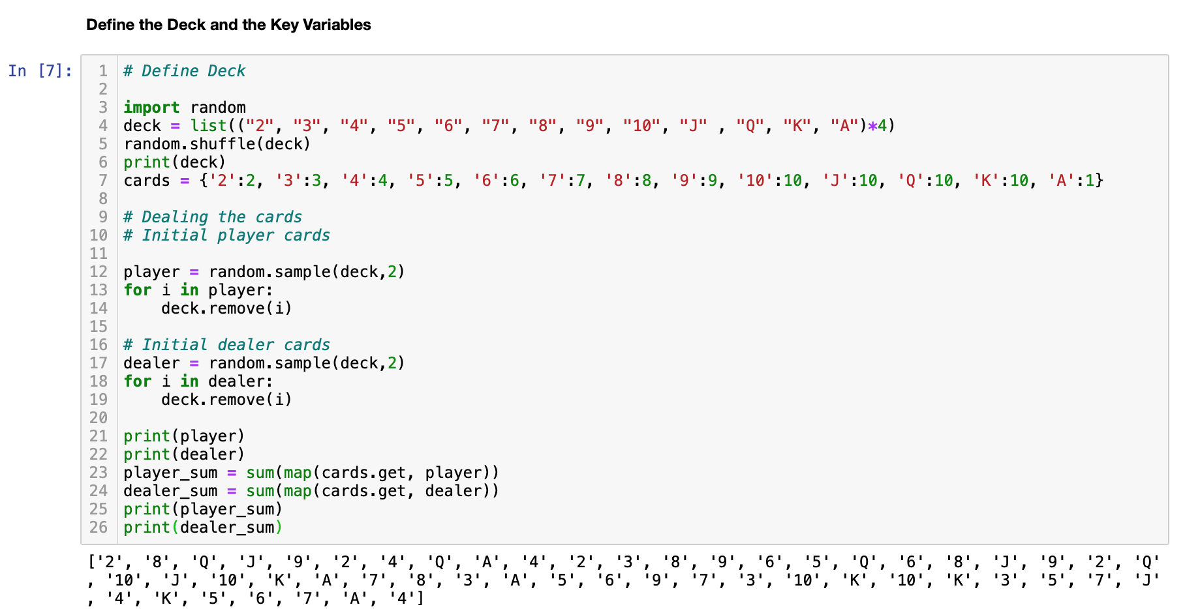
Screenshots Version 4076 👵🏻
Defining the Deck

Slide 10
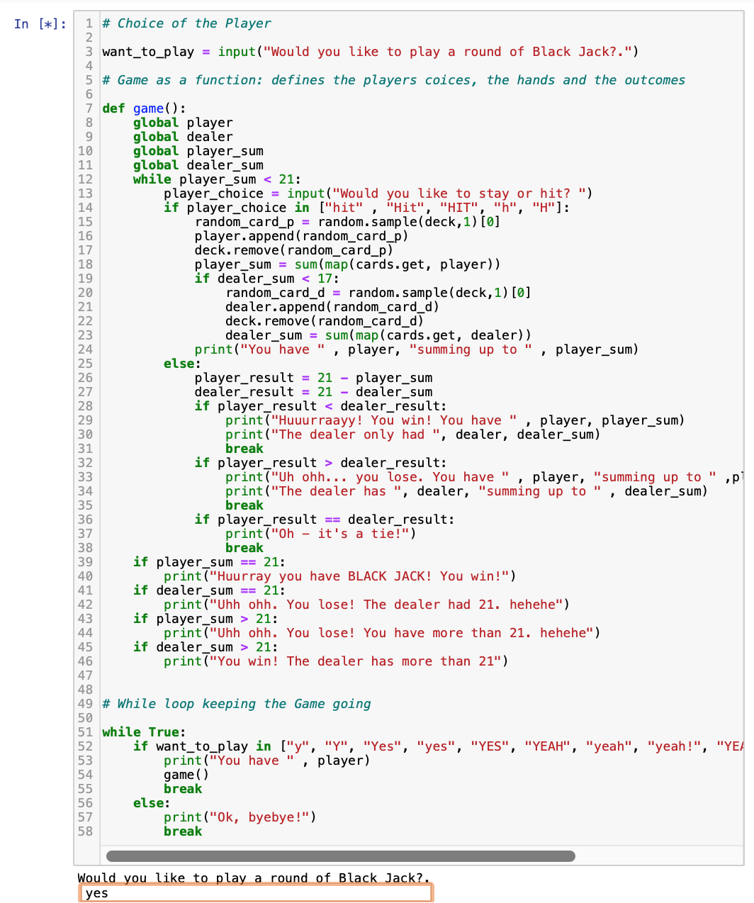
Screenshots Version 4076 👵🏻
Defining the Deck & using functions

Slide 11
DEMO 🤡

Slide 12
Challenges 🥵
Underestimated the time
Underestimated the importance of structured planning
Underestimated the time the rest of the tasks would take

Slide 13
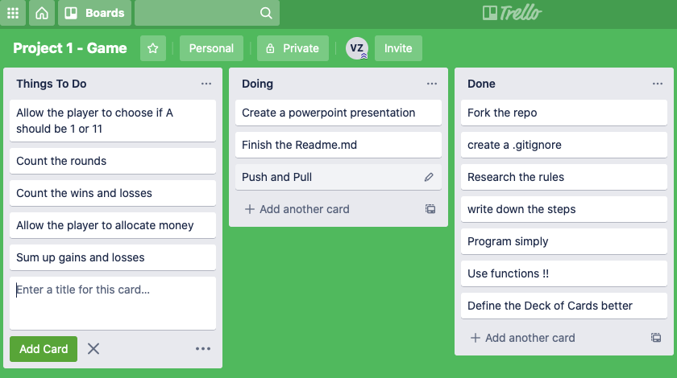
Future improvements 👾

Slide 14
Learnings 🤓
Learned from my mistakes that Ali helped me with (global variables in fuctions)
Leave time to implement extra features – Planning ahead helps
Leaving the screen after a long period of concenration helps a lot

Slide 15
Thank you! 🐍🤗🎉

